Slide 1
Database Testing
Using SQL

Slide 2
What is Database?
Database is an organized collection of data so that it can be easily accessed and managed.

Slide 3
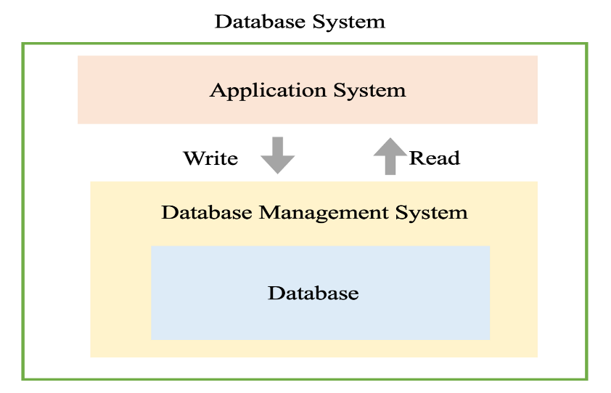
What is SQL?
SQL Stands For Structured Query Language.
It is a programming language used to take to databases.
What is Database Management System?
A DBMS is a Tool that serves as an interface between an end-user and a database, allowing users to create, read, update, and delete data in the database.
Types Of Database Management Systems?
SQL Lite
MySQL
Oracle
Postqre SQL

Slide 4
Entity Relationship Diagram (ERD)
An entity relationship diagram (ERD) is a graphical representation that represents relationships among people, objects, places, concepts or events within an (IT) system.
Importance Of ERDs :
Provide a visual starting point for database design.
an ERD can still serve as a reference point, should any debugging or business process re-engineering be needed later.

Slide 5
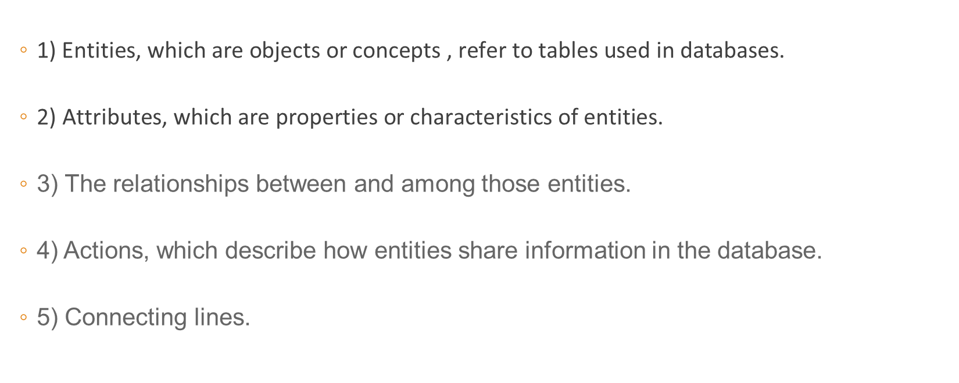
There are five components of an ERD
1) $\text{Entities}\text{, }\text{which} \text{are} \text{objects} \text{or} \text{concepts}\text{ , }\text{refer} \text{to} \text{tables} \text{used} \text{in} \text{databases}\text{.}$
$\text{2) }\text{Attributes}\text{, }\text{which} \text{are} \text{properties} \text{or} \text{characteristics} \text{of} \text{entities}\text{.}$
3) The relationships between and among those entities.
4) Actions, which describe how entities share information in the database.
5) Connecting lines.

Slide 6
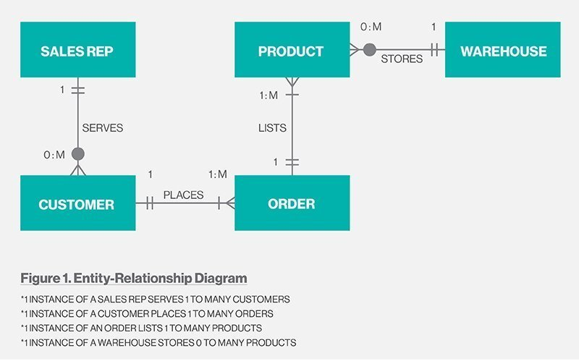
ERD Example :

Slide 7
There Are Three Main Cardinalities :
A one-to-one relationship (1:1). For example, if each customer in a database is associated with one mailing address.
A one-to-many relationship (1:M). For example, a single customer might place an order for multiple products. The customer is associated with multiple entities, but all those entities have a single connection back to the same customer.
A many-to-many relationship (M: N). For example, Student Can Enroll into multiple Courses And Courses can be Enrolled by Multiple Students.

Slide 8
Practical Example
Lunch Microsoft SQL Management Studio and Implement The ERD Mentioned In The Document.
Notes:
The HAVING clause is used with aggregate functions, but the WHERE keyword cannot be used with aggregate Functions .

Slide 9
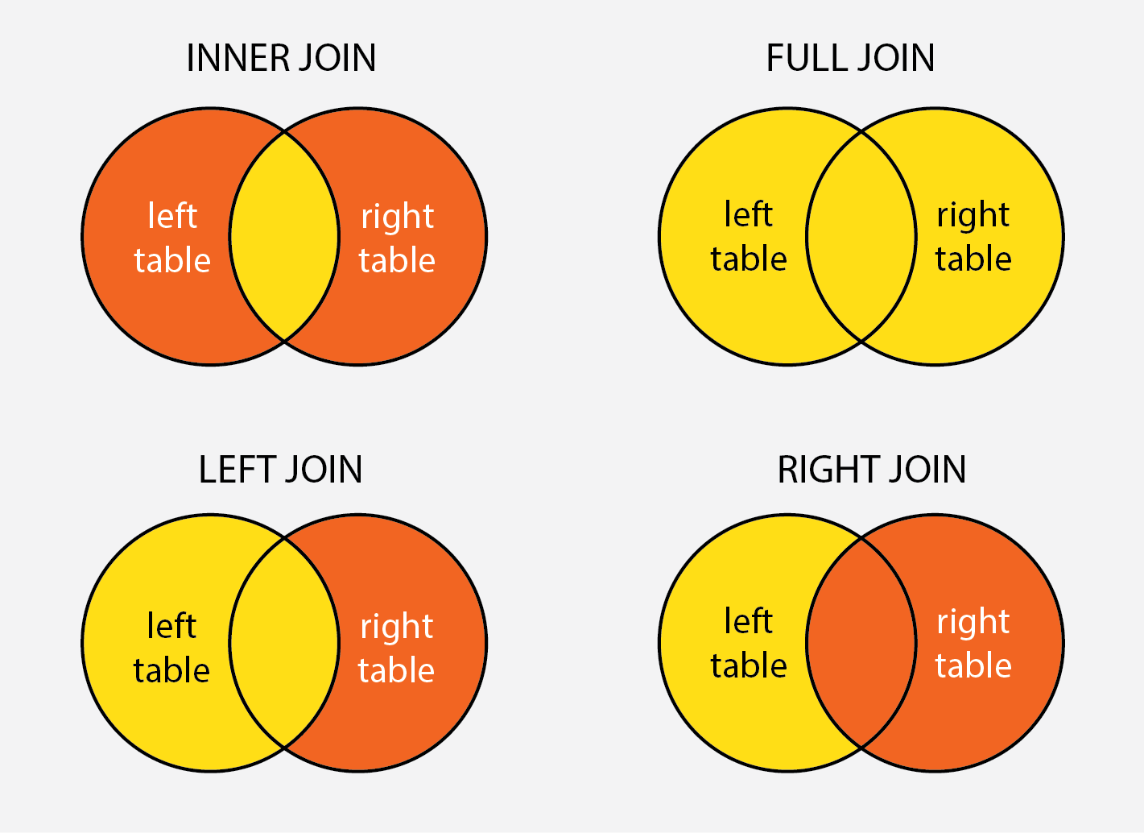
SQL Joins
A JOIN clause is used to combine rows from two or more tables, based on a (related/Common) column between them.
Inner Join
Left Join
Outer Join
Full Join(full outer join)
Notes:
The HAVING clause is used with aggregate functions, but the WHERE keyword cannot be used with aggregate Functions .

Slide 10
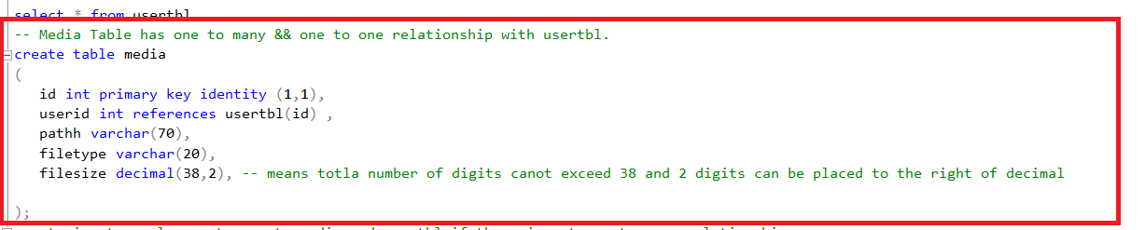
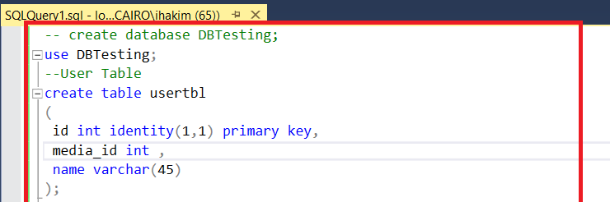
Database And Tables
Notes:
Decimal(65,2) : means total number of digits cannot exceed 65 and 2 digits are placed to the right of decimal

Slide 11
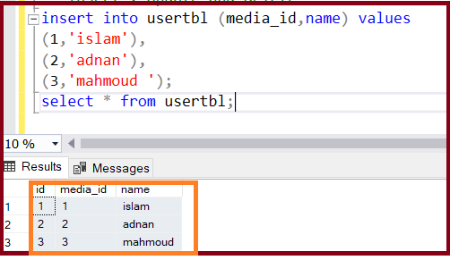
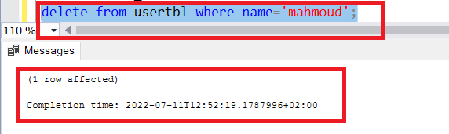
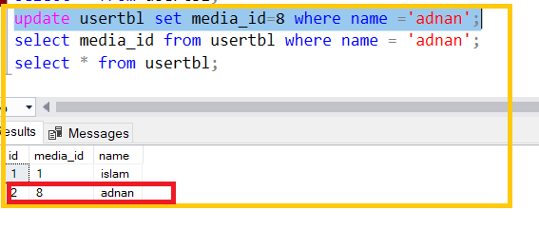
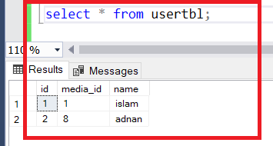
Insert, Update and Delete
Notes:
Move ordinal

Slide 12
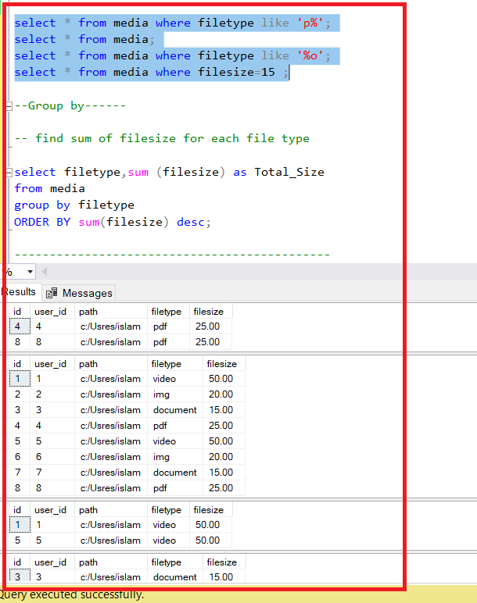
Select – Where condition

Slide 13
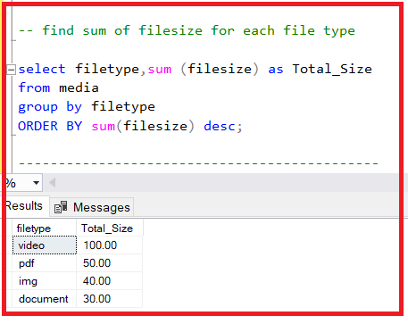
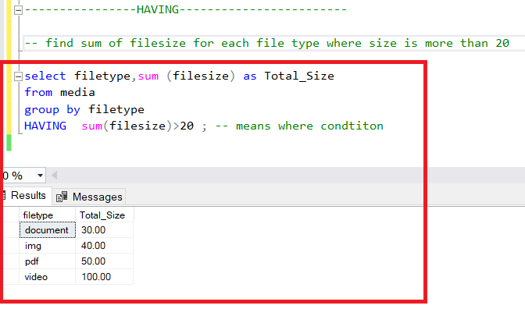
Group By – Having
The GROUP BY statement groups rows that have the same values into summary rows, like "find the number of customers in each country".
The GROUP BY statement is often used with aggregate functions (COUNT(), MAX(), MIN(), SUM(), AVG()) to group the result-set by one or more columns.
Having clause is used with aggregation functions instead of where.
Notes:
The HAVING clause was added to SQL because the WHERE keyword cannot be used with aggregate functions.

Slide 14
Stored Functions & Stored Procedure
Functions | Stored Procedure
Always returns a single value; either scalar or a table. | Can return zero, single or multiple values.
Only Select statements. DML statements like update & insert are not allowed. | Can perform any operation on database objects including select and DML statements.
Allows only input parameters. Does not allow output parameters. | Allows both input and output parameters
Cannot call a stored procedure from a function. | Can call a function from a stored procedure.
Functions can be called from a Select statement. | Execute statement has to be used to execute a stored procedure.
Notes:
A stored procedure is more flexible to write any code that you want, while functions have a restricted structure and functionality.

Slide 15
Table-Valued Function Example | Stored Procedure Example
CREATE function GetEmployeeListmediamorethanOne(@media_id int) RETURNS TABLE AS RETURN SELECT * FROM usertbl where usertbl.media_id>@media_id; | CREATE PROCEDURE InsertUsers ( @media_id int, @name nvarchar(50) ) AS BEGIN INSERT INTO usertbl (media_id,name) VALUES ( @media_id,@name ) END
-- U must declare db.schema.funcName to call it select * from DBTesting.dbo.GetEmployeeListmediamorethanOne(1); | exec InsertUsers @media_id=100,@name=islam';
Notes:
A stored procedure is more flexible to write any code that you want, while functions have a restricted structure and functionality.

Slide 16
How To Test Database
Check The ERD (review it for any missing attributes, relationships, and tables).
Column Testing (Field lengths/Data types).
Any UNIQUE or NOT NULL characteristics of keys.
Stored Functions Testing.
Stored Procedures validate that when the user executes a Procedure, the correct result will be retrieved and displayed to the user.

